Slide 1
Application elements
GUI
Logic
Data

Slide 2
Platform independent. Classes for each element
GUI
Web based app
LOGIC
Data
Landroid basedappOGIC

Slide 3
Characteristics
OOP
Distributed i.e. via the cloud (java applets not used anymore. Now got Javascript)
Javascsript – front end GUI language
References used instead of memory pointers
Boolean data type have value of true or false
Memory management is automatic
Multi threaded
Secure – type safe language – less prone to buffer overflow attack. Can do garbage collection, to prevent memory leaks
Platform independent programs

Slide 4
linux/unix
JRE
Make into machine readable language
Main.java
main.class
e.g. java byte code
windows OS
JRE
compile
1) JVM(Javavirtualmachine)
These are needed to run java byte code
OS have built in java
2) JDK (Java Dev kit)
- contains APIs and libraries
Solaris
JRE
Android JRE
*JRE is platform dependent

Slide 5
Java EE – Java SE + networking APIs (for databases)
Java SE + Android – adequate
Java ME for embedded..TV..mobile..card…but not used these days
Need to master libraries in java sdk.. Need time.
Can run different versions of Java SDK at the same time.

Slide 6
Development tools
IDE (integrated development environment)
Example:
Netbeans *simplified
Eclipse Neon *Recommended
Android Studio *Mobile

Slide 7
Command line tools
javac.exe
java.exe
SET the path to use javac.exe anywhere inside cmd without navigating to the jdk bin folder:
C:\>path = “C:\Program Files\Java\jdk1.7.0_79\bin”
Then C:\Labs\les02>javac CalcAverage.java
Java file is compiled and do a DIR to see this new Class:
CalcAverage.class
To run the class, type java followed by the Class name:
Java CalcAverage
OR use the IDE netbeans to open. Easy to run and compile.

Slide 8
Netbeans
Click Menu/tools – Java platforms
Add all the versions of java jdk to support many versions within same Netbeans by:
Click “Add Platform”
Select jdk version in directory
Right click on PROJECT Application.
Click Propeties to change Java Version to support.
Java SE SDK + Java ME SDK support mobile development

Slide 9
Lesson 3 - OOP
UML to design a class (examinable)
Problem Domain/Statements – SCOPE of problem to solve
E.g. an order application must be created, with an option to add a new customer by entering customer id, customer name, customer address. The customer must be given an option to search an existing order by entering an order ID
Use this to extract Objects for Java
GUI, Data, Logic – OBJECTS
Logic object

Slide 10
Extract LOGIC OBJECTS by nouns + verbs
E.g. an order application must be created, with an option to add a new customer by entering customer id, customer name, customer address. The customer must be given an option to search an existing order by entering an order ID
Objects:
Order
Attributes:
Order ID
Customer
Attributes:
ID
Name
Address
Methods(apply to both Order and Customer:
Add
Update
Delete
search
Nouns:
Order
Customer
ID
Name
Address
Verbs:
Add
Search
entering

Slide 11
Parts of an Object 1. Data: Attributes, Properties, Variables, fields 2. Logic: Methods, functions. Executed by programmers. 3. GUI: Event e.g. click, similar to methods. Both contain ACTIONS. But Event not controlled by programmer. E.g. Event: Public Static Void Main
Attributes, Properties, Variables, fields
LOGIC: Object
dfdfd
dfdfd

Slide 12
HIBERNATE.ORG
Map Java objects
Plug in to netbeans/eclipse

Slide 13
UMLET.com
Download stand alone link for UMLet
Arrow: 1 to many illustrated by 1..* beside the arrow
* denotes inheritance

Slide 14
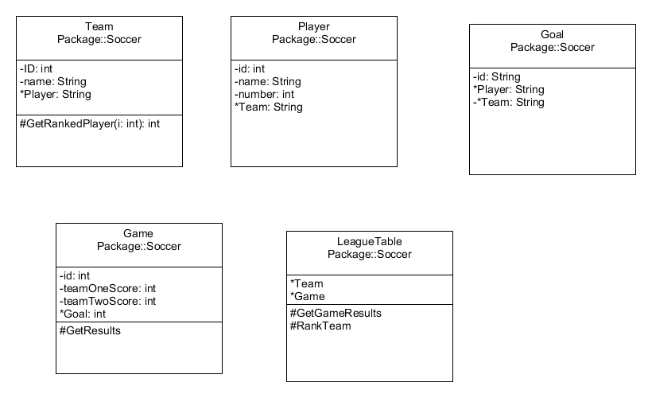
Exercise-A soccer league needs a system to track team and player standings. At any moment, administrators want to be able to report a list of games played with results, a list of teams ranked by wins, and a list of players on each team ranked by goals scored.
Nouns
Team
Player
Games
League
goals
Verbs
Get Rank
Get Game Results

Slide 15
Public static void main(args)
Is an Event, not attribute nor method
Execute right away upon application did load

